Slide 1
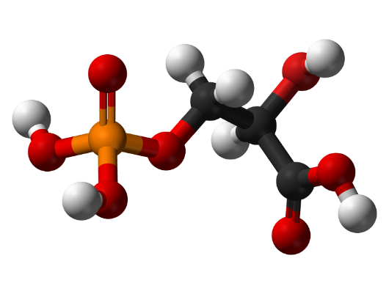
Lipoteichoic Acid
Challenge in LTA Simulation
LTA is a large polymeric biomolecule
Full DFT simulation → computationally impractical
Need a scientifically valid alternative approach
Component-Based Modeling Strategy
Decompose LTA into representative molecular units
Simulate each component using DFT
Combine spectral contributions to reconstruct LTA fingerprint
Structure of Lipoteichoic Acid
Lipoteichoic acid consists of three structural components:
• Glycolipid membrane anchor • Poly(glycerol–phosphate) backbone • Substituent groups such as D-alanine residues or sugars
“Fragment-based modeling is a standard approach for large biomolecules”

Slide 2
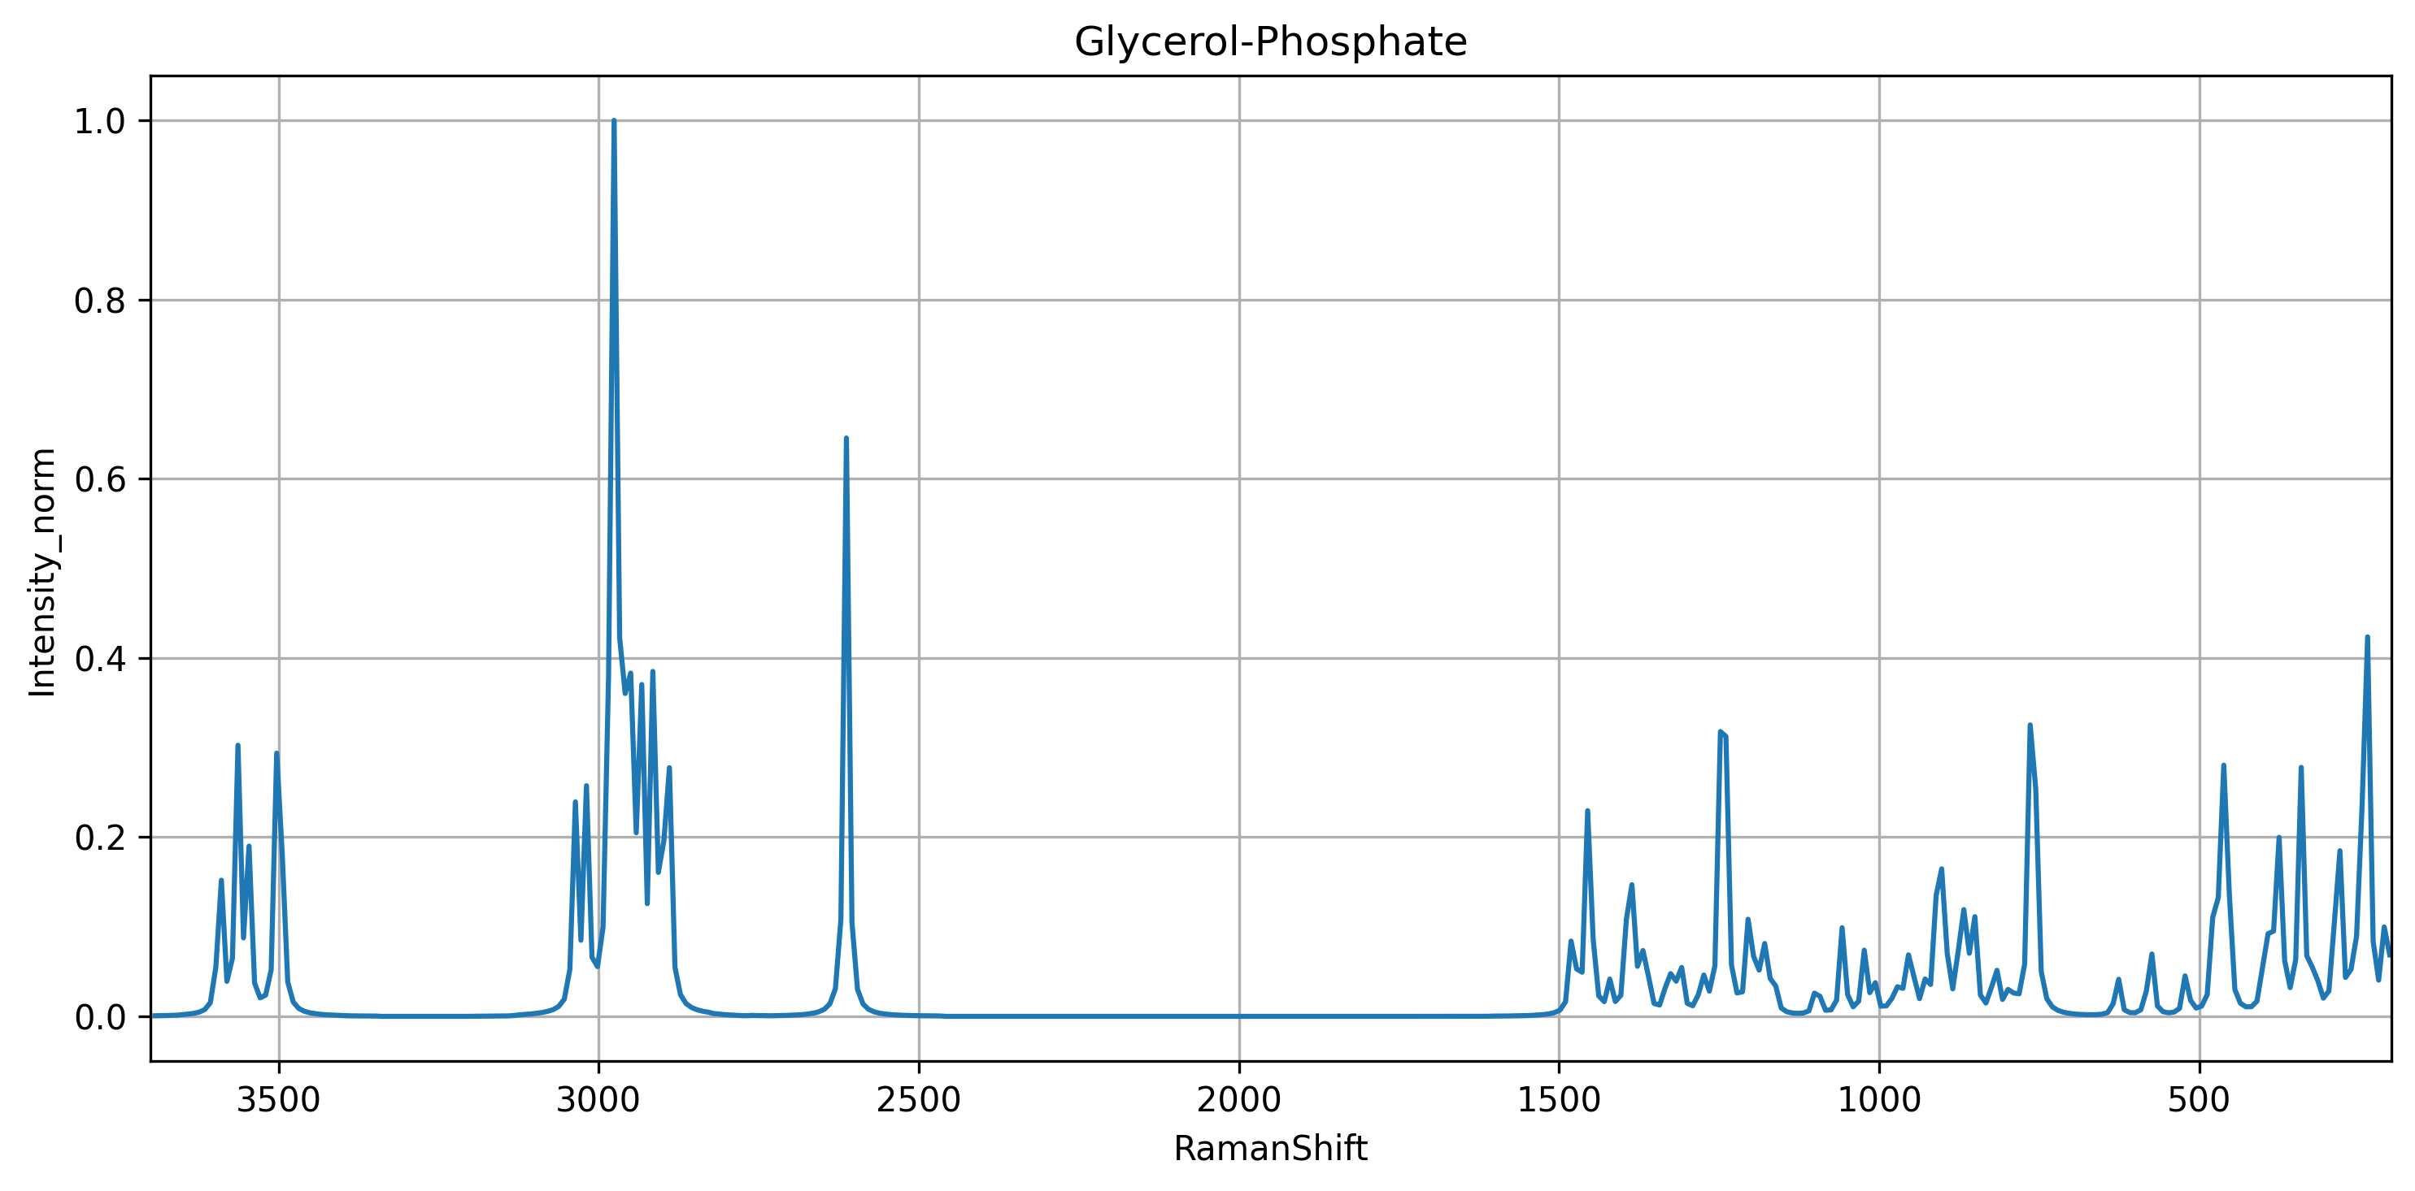
DFT Simulation Method
Quantum-chemical calculations were performed using Gaussian 16.
The simulation included:
• geometry optimization • vibrational frequency calculation • Raman activity calculation
Parameter | Value
Functional | B3LYP
Basis set | 6-31G(d)
Solvent model | SMD (water)
Gaussian keywords used:
# B3LYP/6-31G(d) Opt Freq Raman SCF=Tight Int=UltraFine SCRF=(SMD,Solvent=Water)
Explanation:
SCF=Tight ensures strict electronic convergence
Int=UltraFine improves numerical accuracy
SCRF=SMD models the aqueous environment in which LTA normally exists
DFT frequencies typically overestimate vibrational frequencies, so a scaling factor is applied.
Scaled frequency = frequency × 0.96

Slide 3
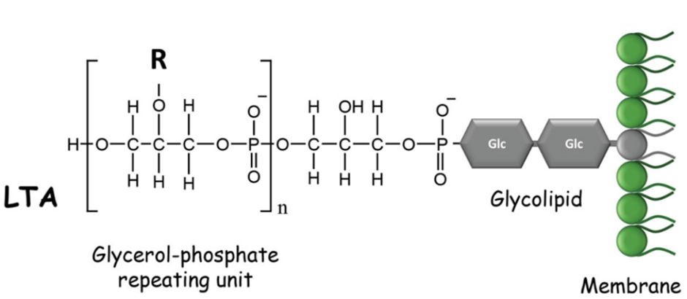
The backbone is composed of repeating units:
glycerol – phosphate – glycerol – phosphate
Typical LTA molecules contain 10–20 repeating glycerol–phosphate units, producing large polymers with hundreds of atoms.
Because the full polymer is computationally expensive for quantum simulations, smaller molecular fragments are often used to represent the local chemical environment responsible for Raman-active vibrations.
General structure:
Lipid anchor – (Gro–P)ₙ
where: Gro = glycerol P = phosphate
LTA contributes to:
bacterial adhesion
cell wall maintenance
activation of host immune responses through receptors such as Toll-like receptor 2

Slide 4
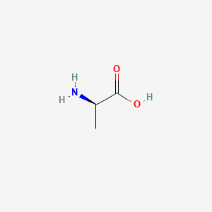
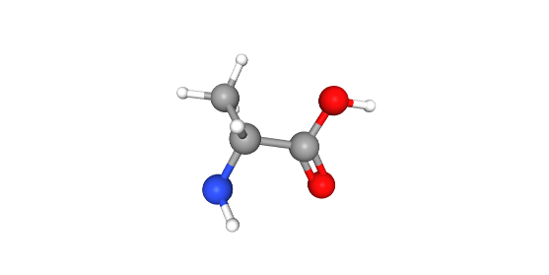
Modeling the LTA Substituent: D-Alanine
Why D-Alanine?
• Represents amino substituent in LTA • Responsible for surface charge regulation • Important for Gram-positive bacterial identification
Molecular Characteristics
2D Structure
• Exists in zwitterionic form: NH₃⁺ – COO⁻ • Contains:
Amino group
Carboxylate group
Methyl group
DFT Simulation Method
• Geometry optimization + Raman calculation • Functional: B3LYP • Basis set: 6-31G(d) • Solvent: SMD (water)
3D Structure

Slide 5
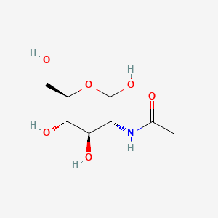
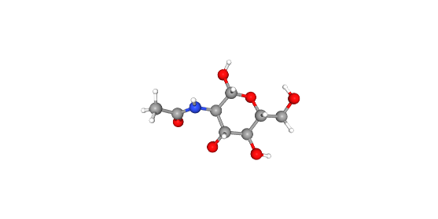
Modeling the LTA Substituent: GlcNAc
Why GlcNAc?
• Represents carbohydrate component • Present in bacterial cell wall structures • Provides strong Raman-active sugar signals
Molecular Characteristics
2D Structure
• Pyranose ring structure • Contains:
Multiple hydroxyl groups (–OH)
Acetamide group (–NHCO–)
C–O–C linkages
DFT Simulation Method
• Geometry optimization + Raman calculation • Functional: B3LYP • Basis set: 6-31G(d) • Solvent: SMD (water)
3D Structure

Slide 6
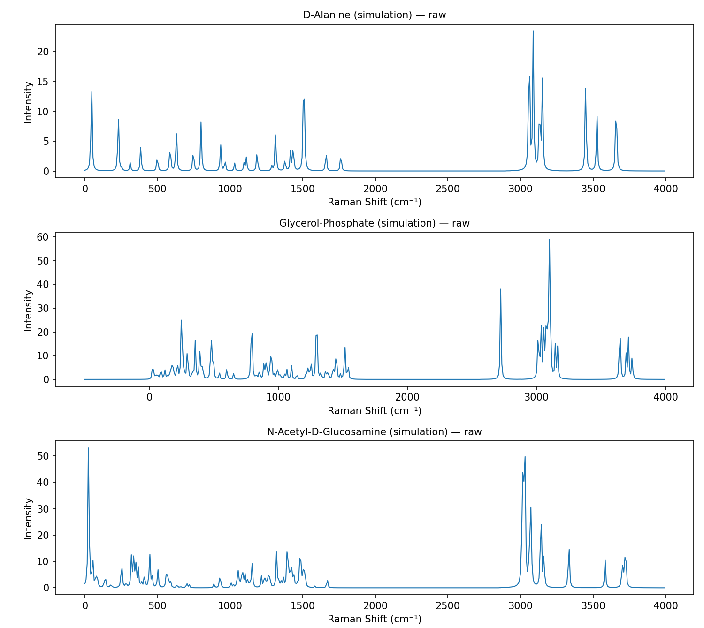
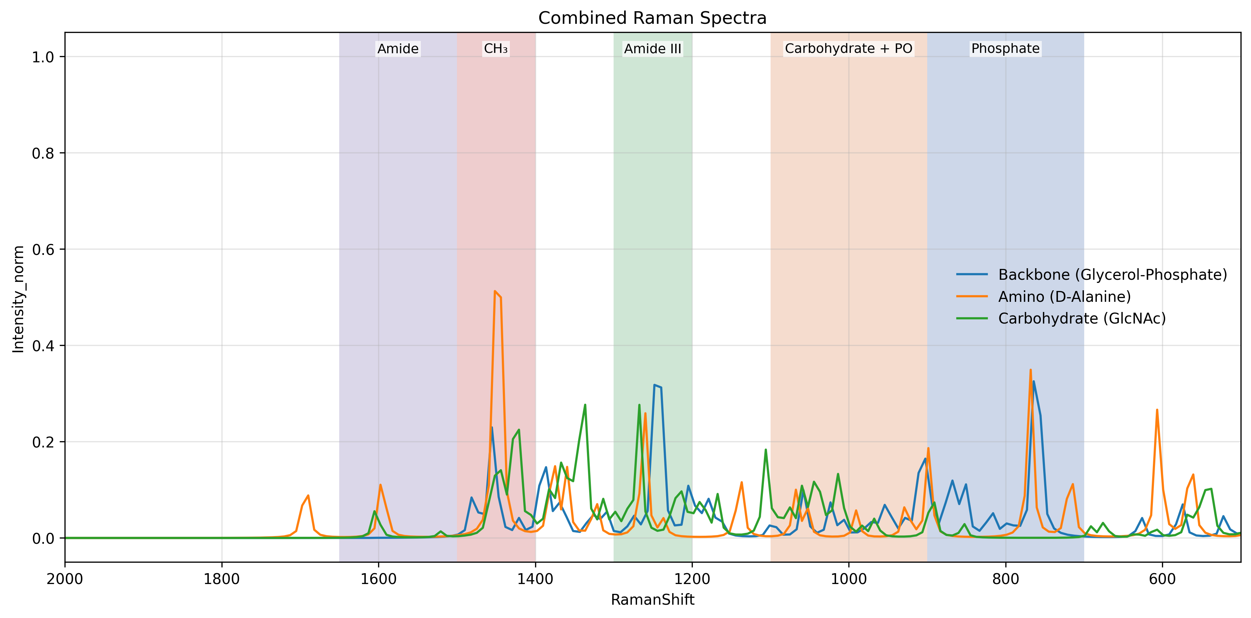
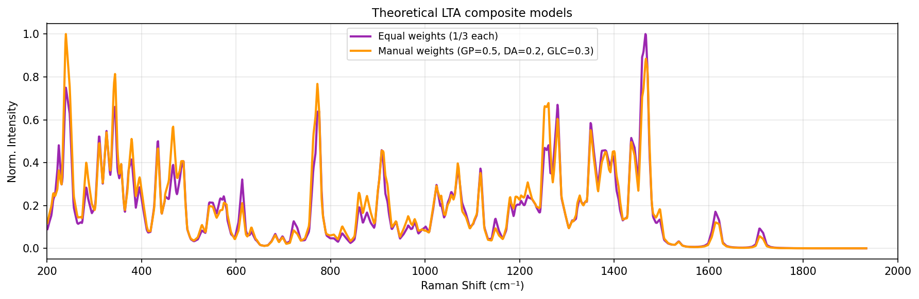

Slide 7
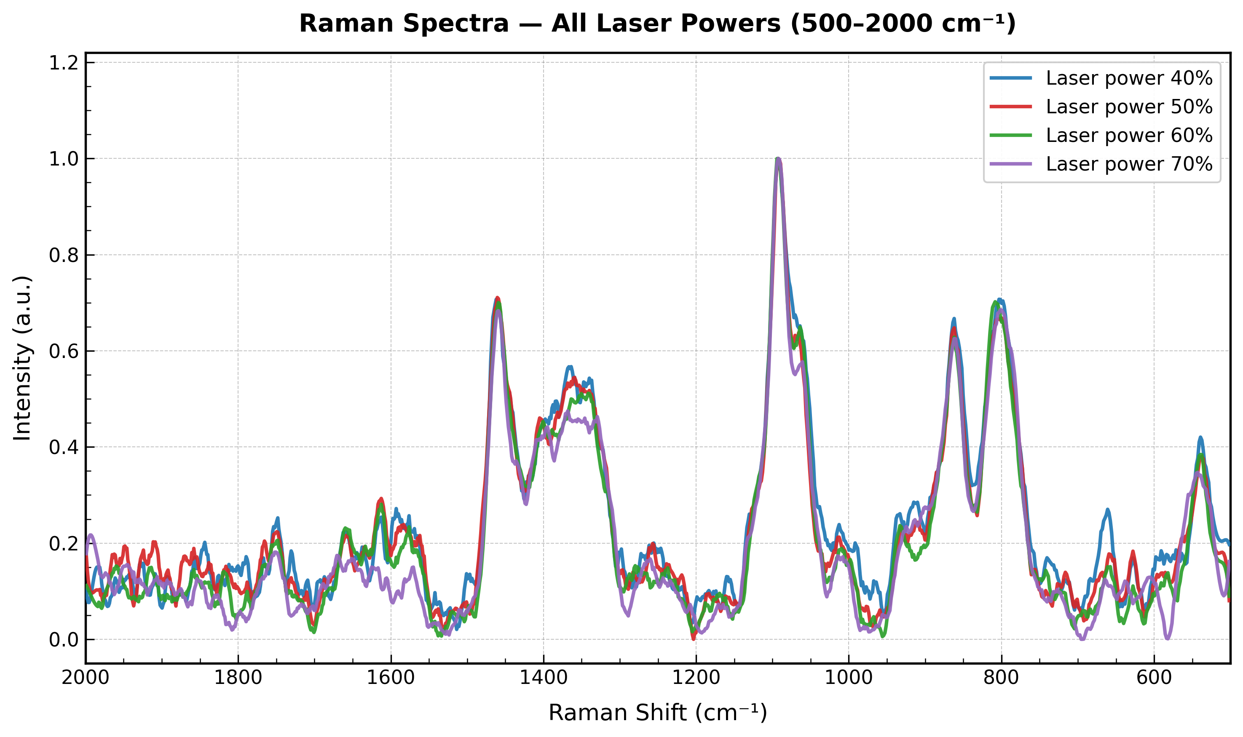
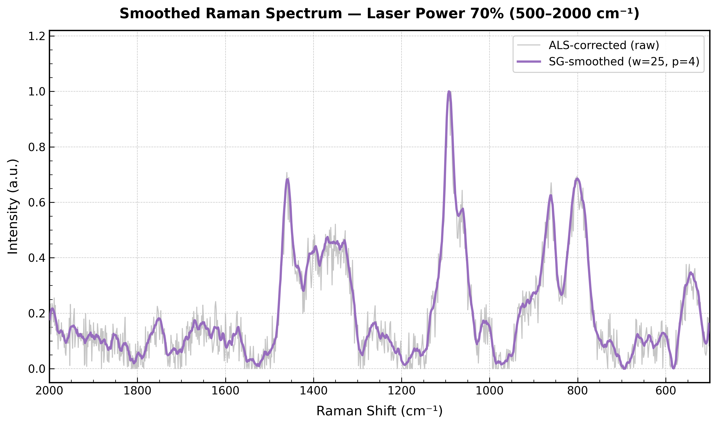
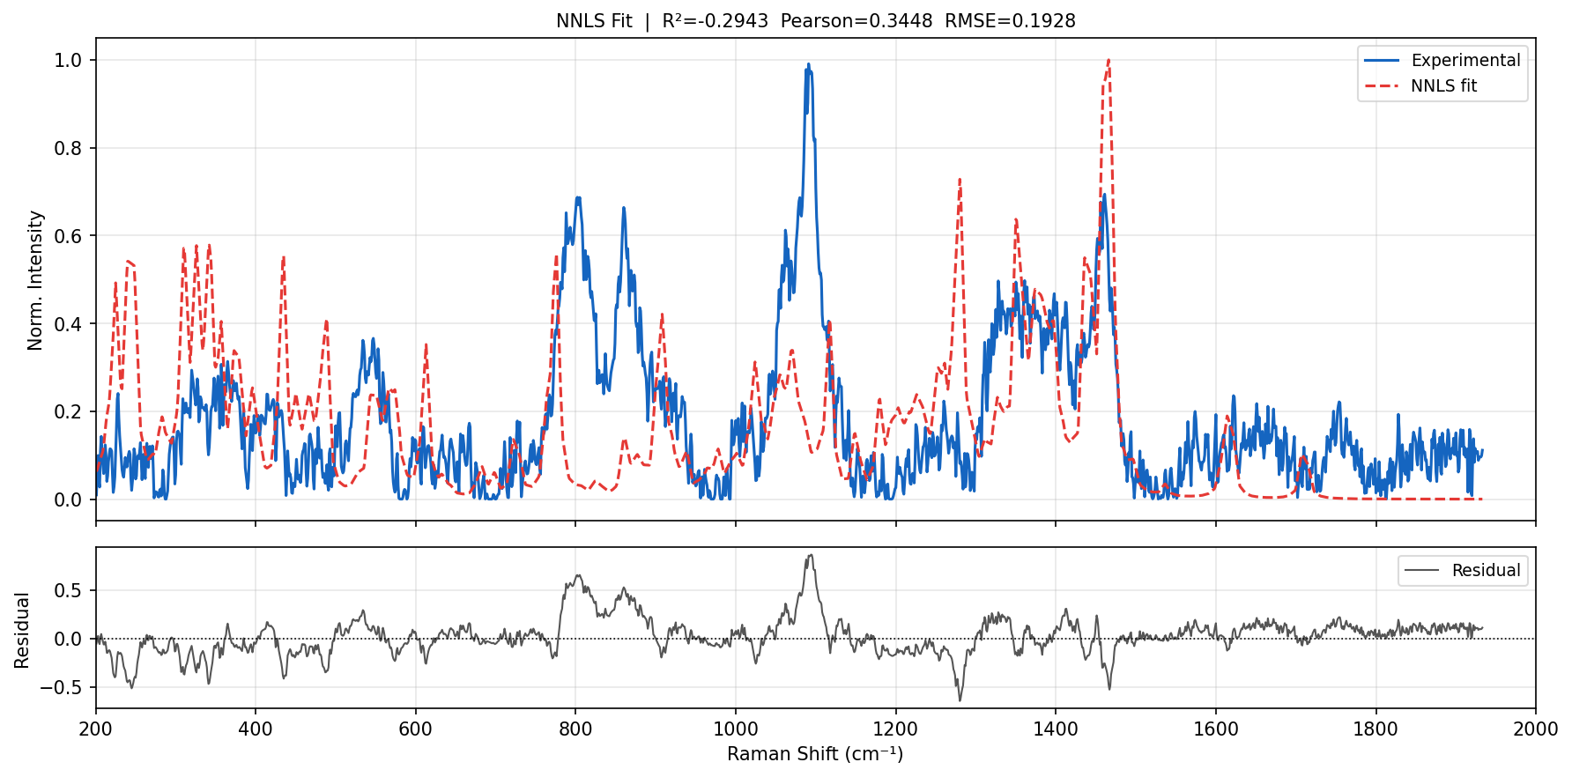

Slide 8
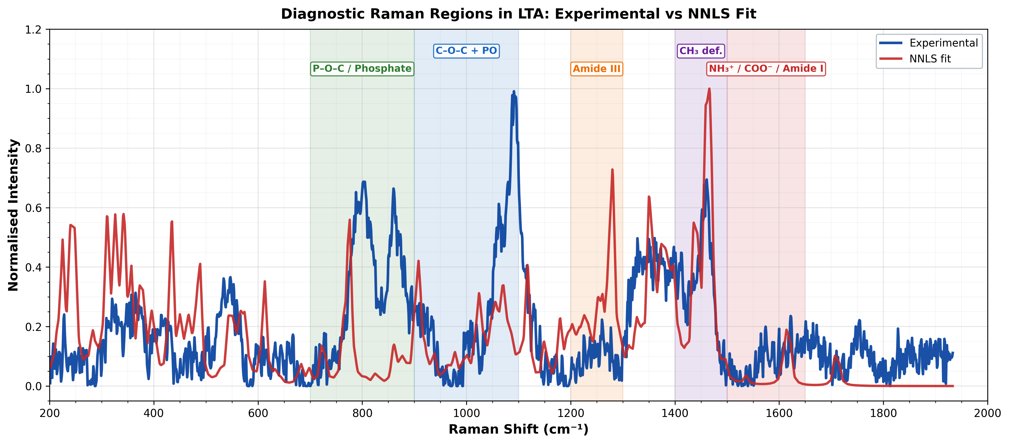

Slide 10
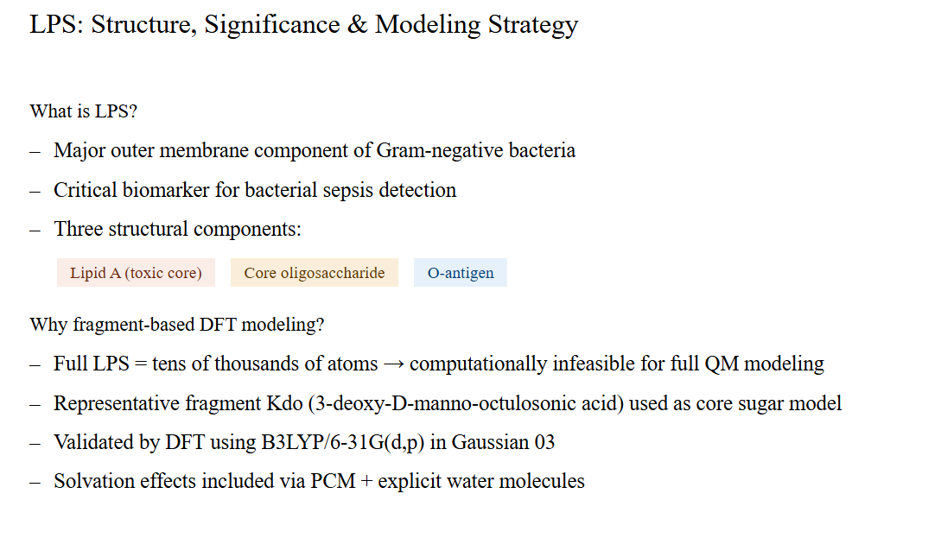
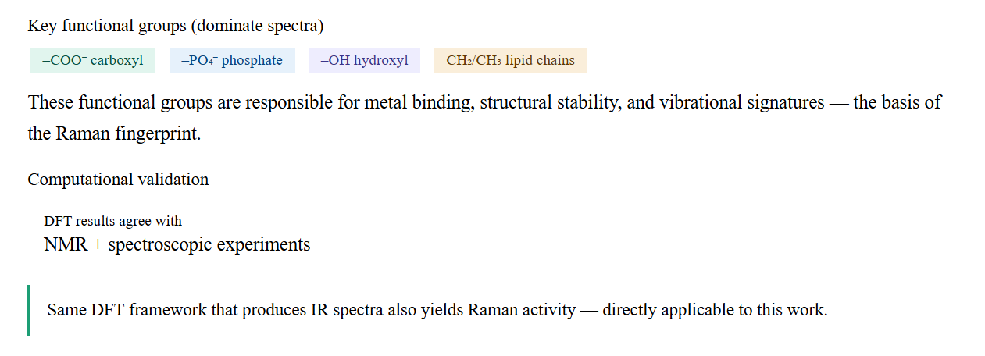

Slide 11
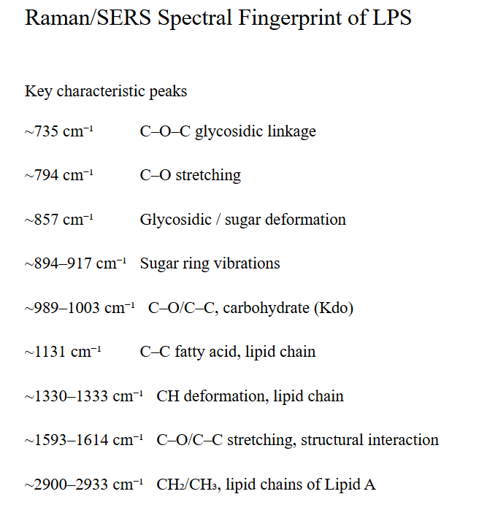
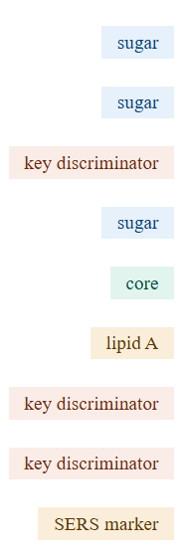

Slide 12
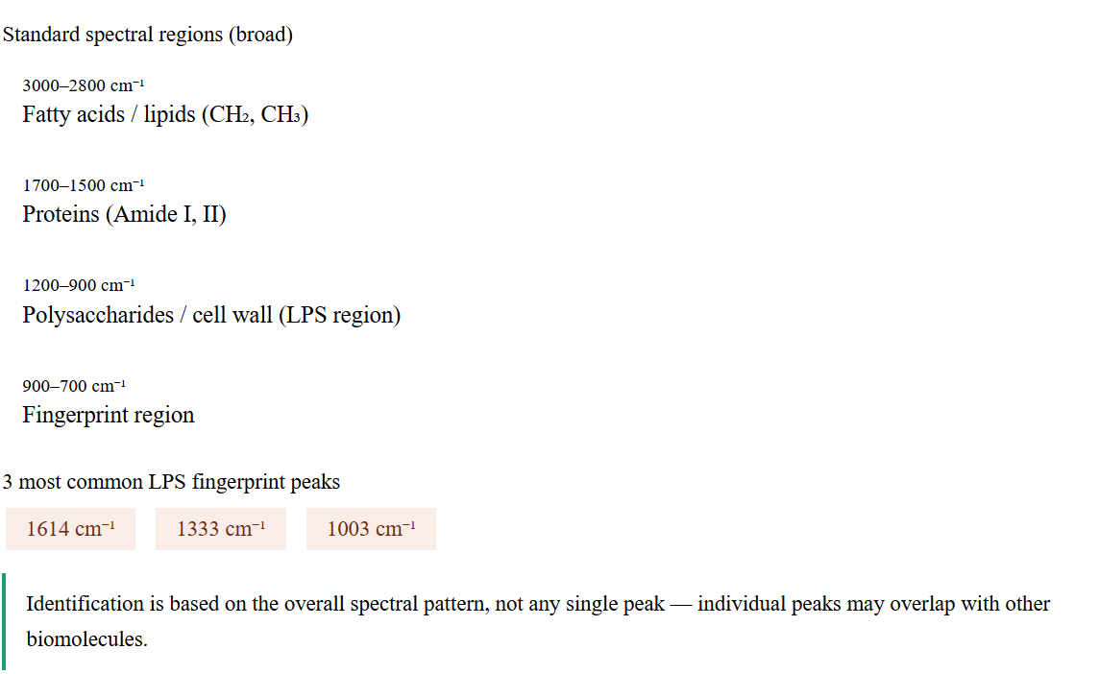

Slide 13
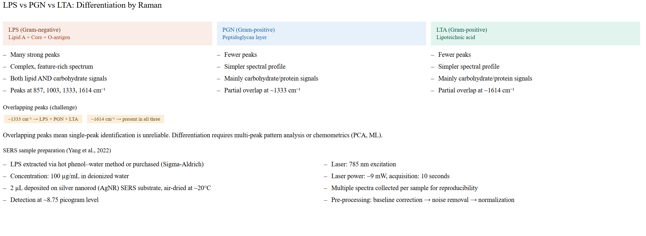

Slide 14
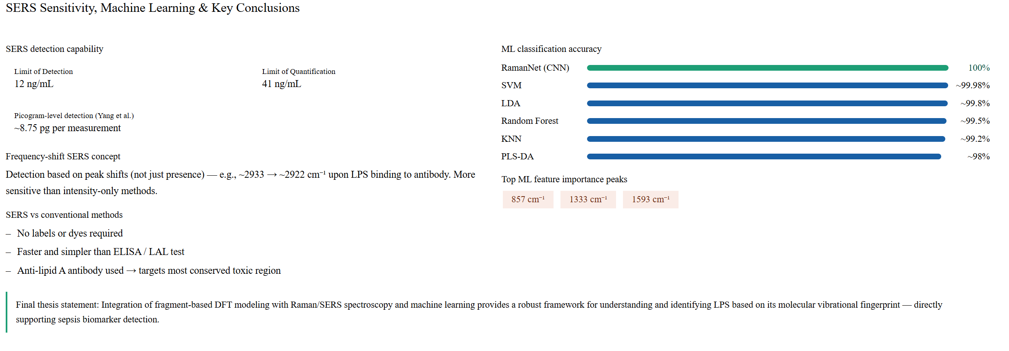

Slide 15
Background
Lipopolysaccharide (LPS) is a major component of Gram-negative bacterial outer membranes.
It is strongly associated with inflammation, endotoxemia, and sepsis.
Rapid identification of LPS-related spectral fingerprints can support diagnostic research.
Raman spectroscopy provides label-free molecular fingerprinting.
Problem Statement
Full LPS is structurally large and complex.
Direct spectral interpretation is difficult due to overlapping bands and multiple functional groups.
Objective
Acquire Raman spectra of LPS powder under optimized conditions.
Build fragment-based computational models representing major LPS substructures.
Compare simulated and experimental spectra.
Identify dominant contributors and characteristic Raman bands.

Slide 16
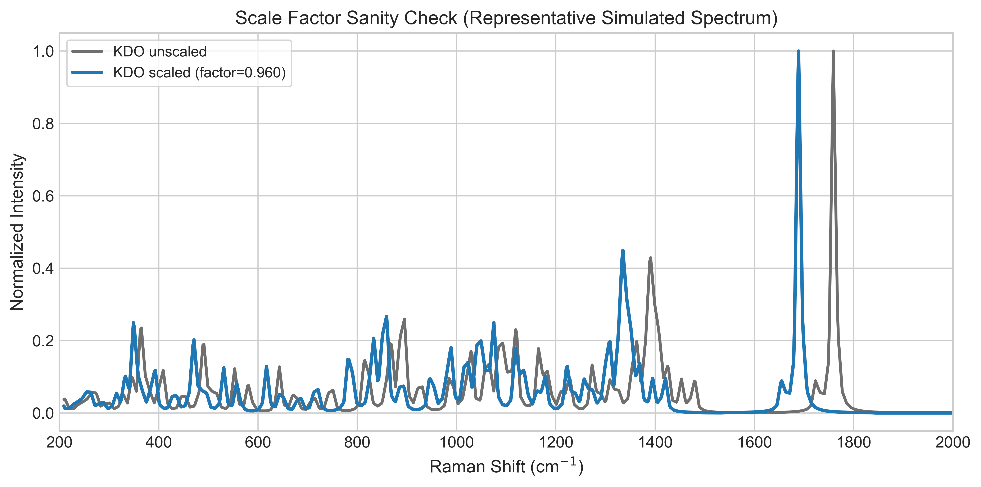
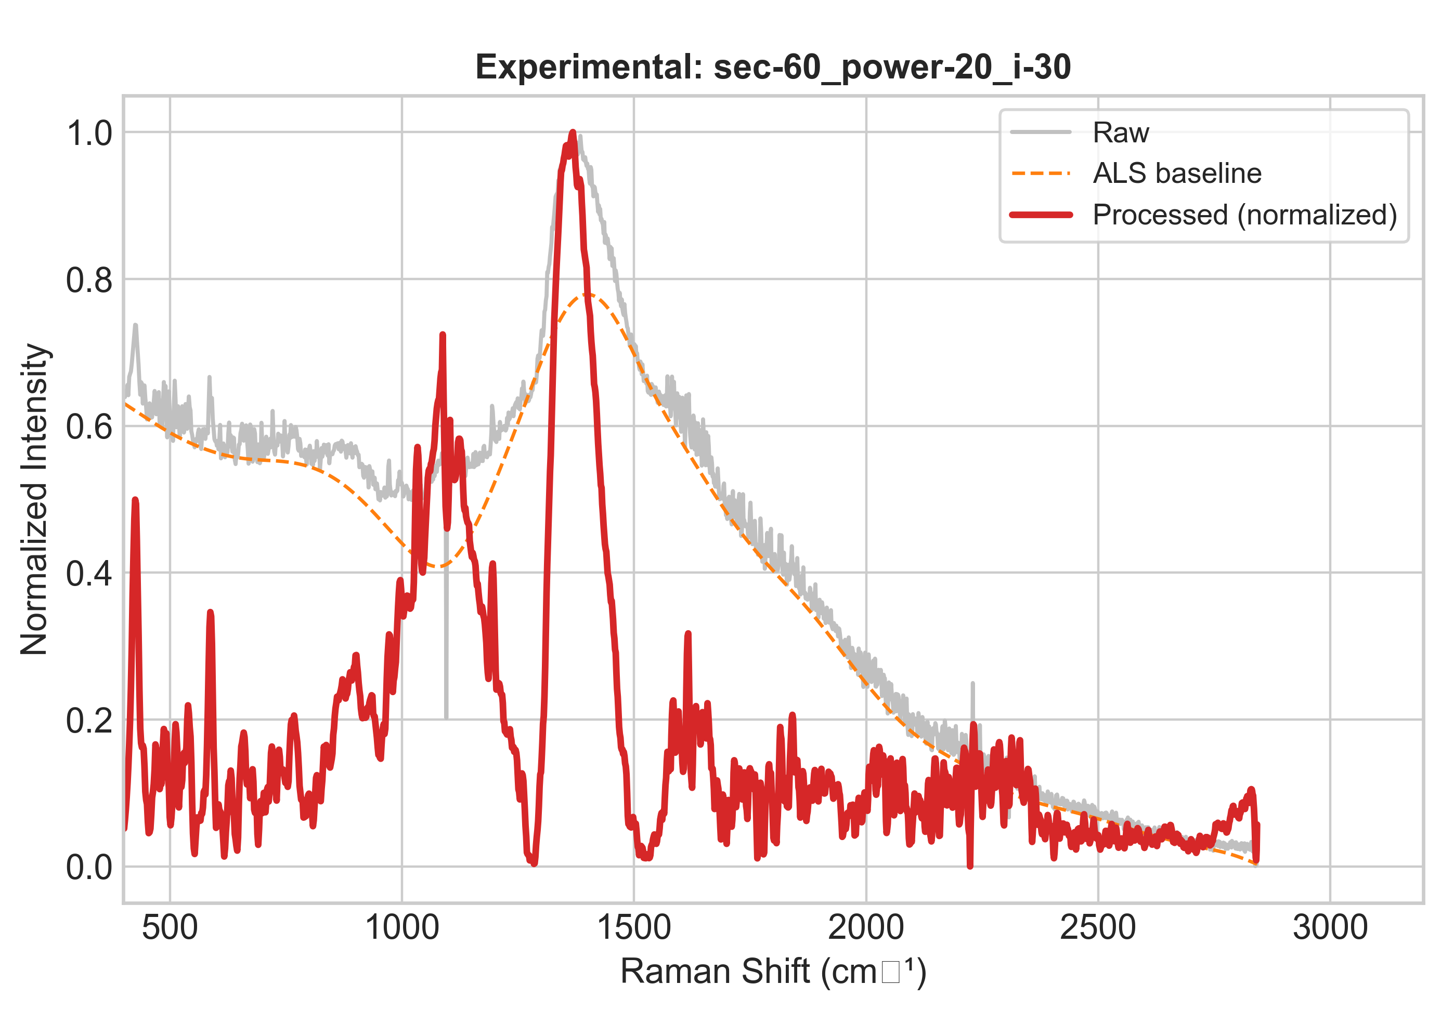
Experimental Workflow
Sample: LPS powder
Raman measurements performed under multiple acquisition settings:
Different integration times
Different laser powers
Different accumulations
Best experimental condition selected based on signal quality and reproducibility.
Optimized Condition Chosen
60 s integration
20% laser power
30 accumulations
Computational Workflow
Representative fragments selected:
KDO
Heptose
D-Glucosamine
Myristic Acid
Phosphoric Acid

Slide 17
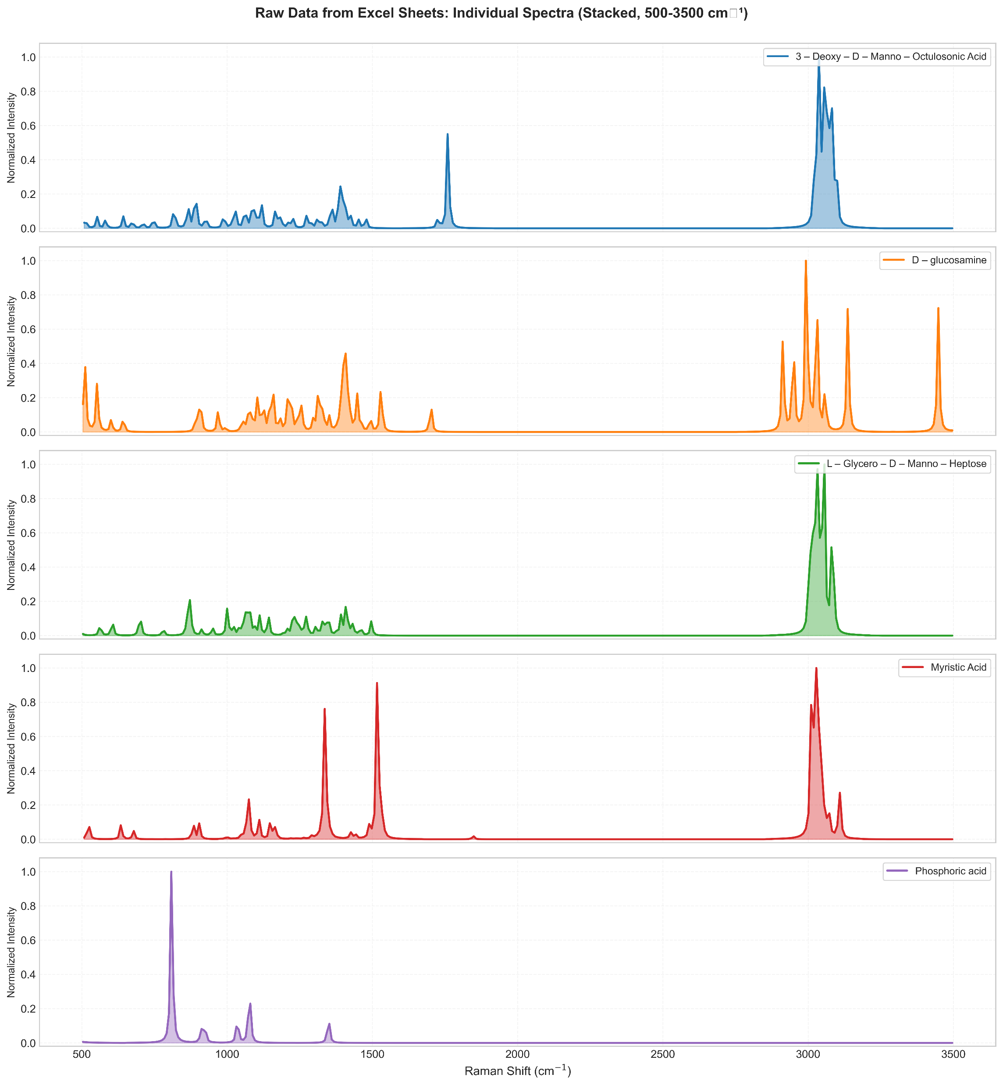
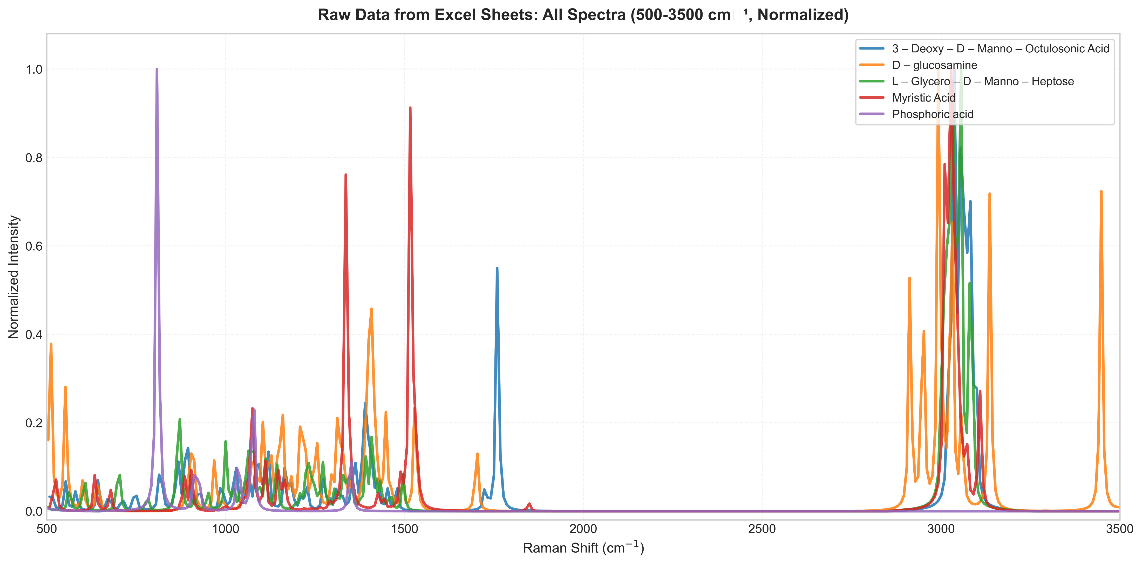
Simulation Method
Geometry optimization
Frequency + Raman calculations
DFT using B3LYP / 6-31G(d)
Data Processing
Interpolation to common Raman grid
Normalization
Composite model generation:
Equal-weight model
NNLS optimized model

Slide 18
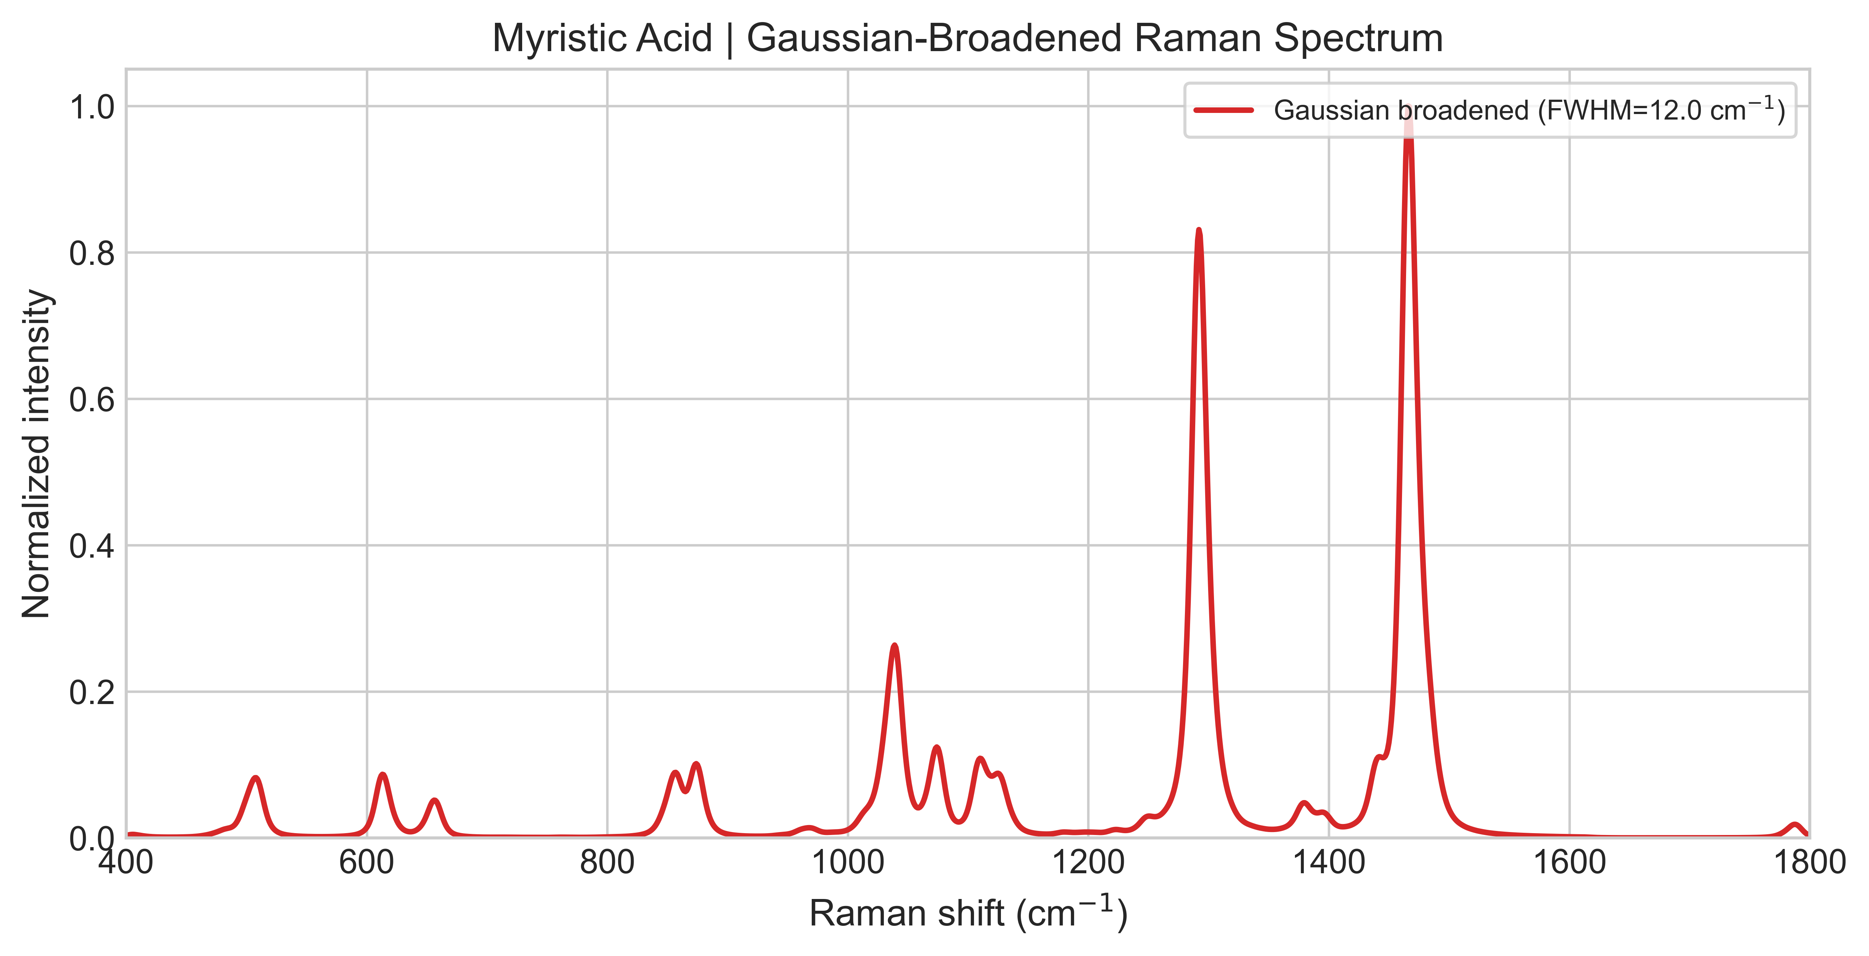
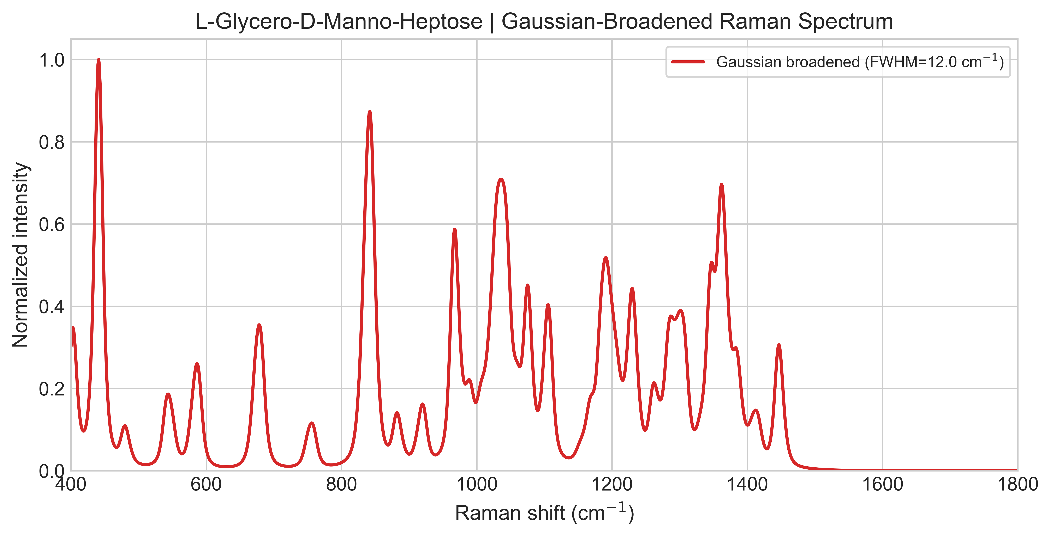
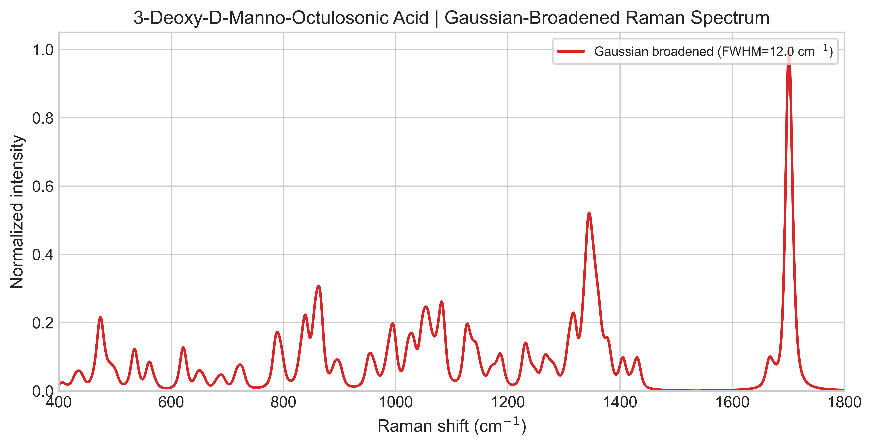
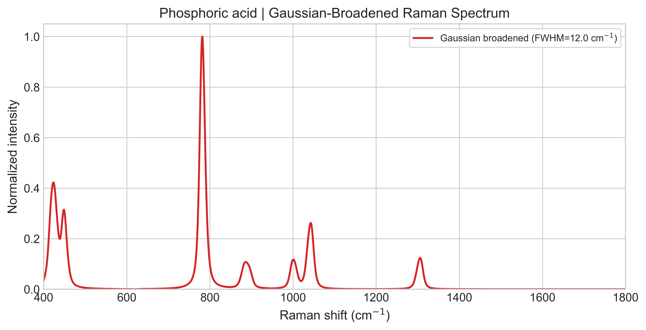
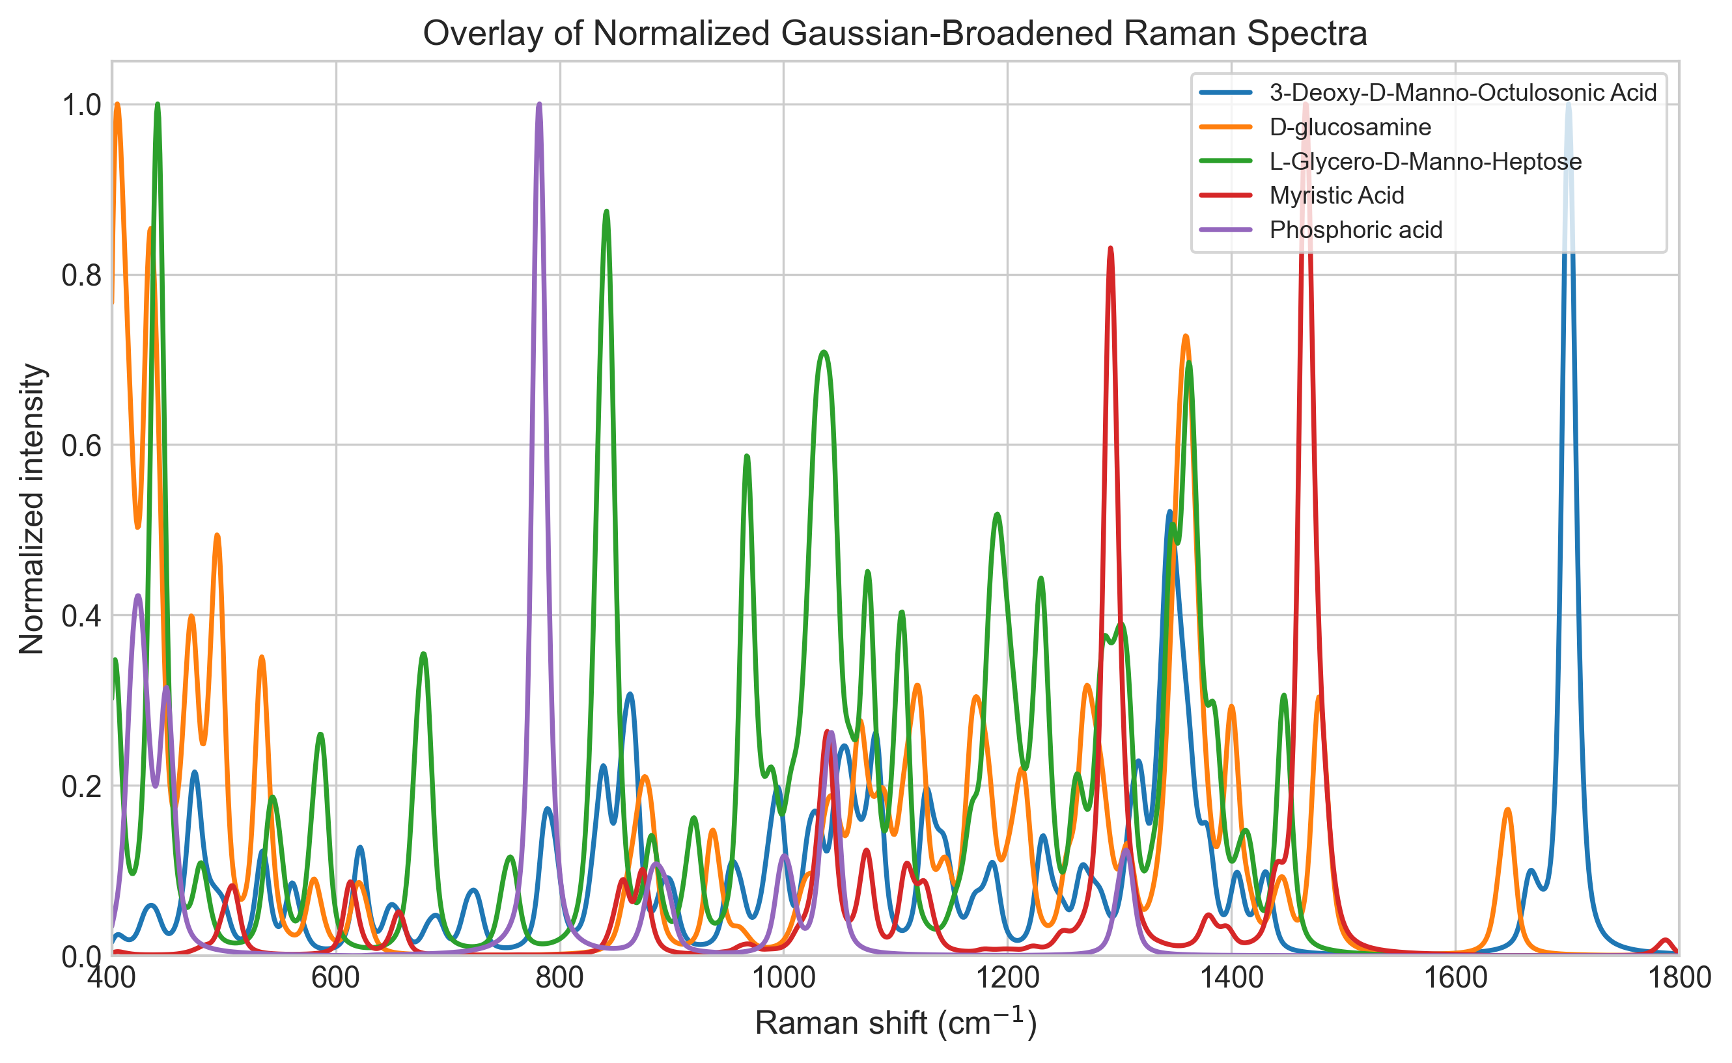
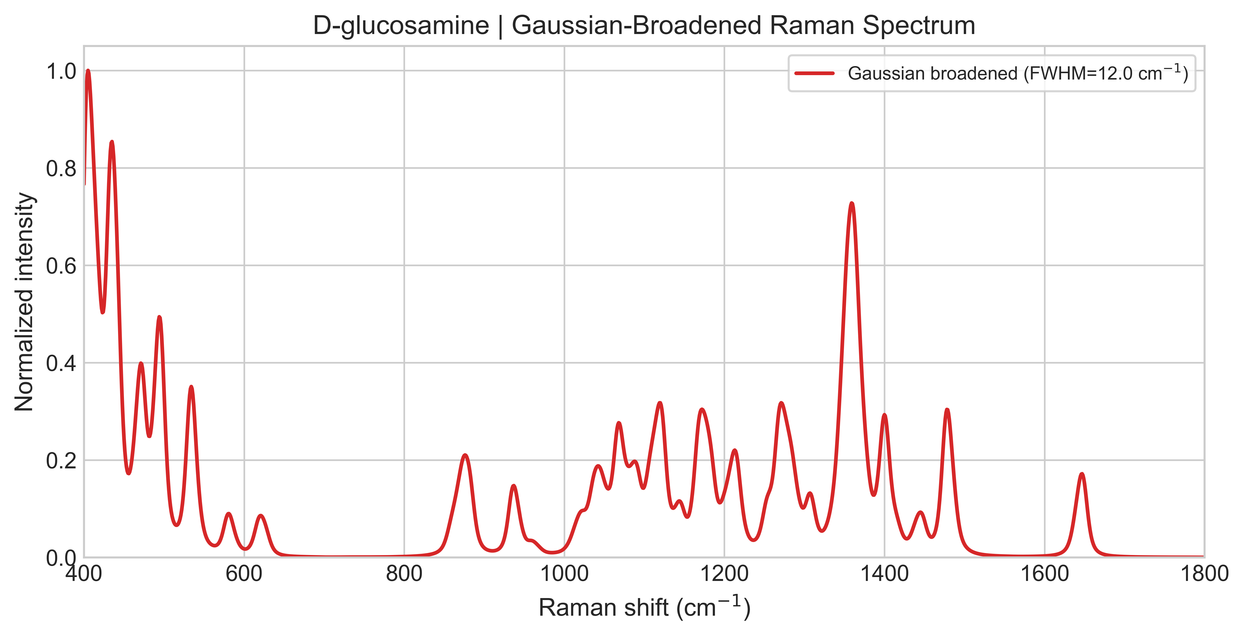

Slide 19
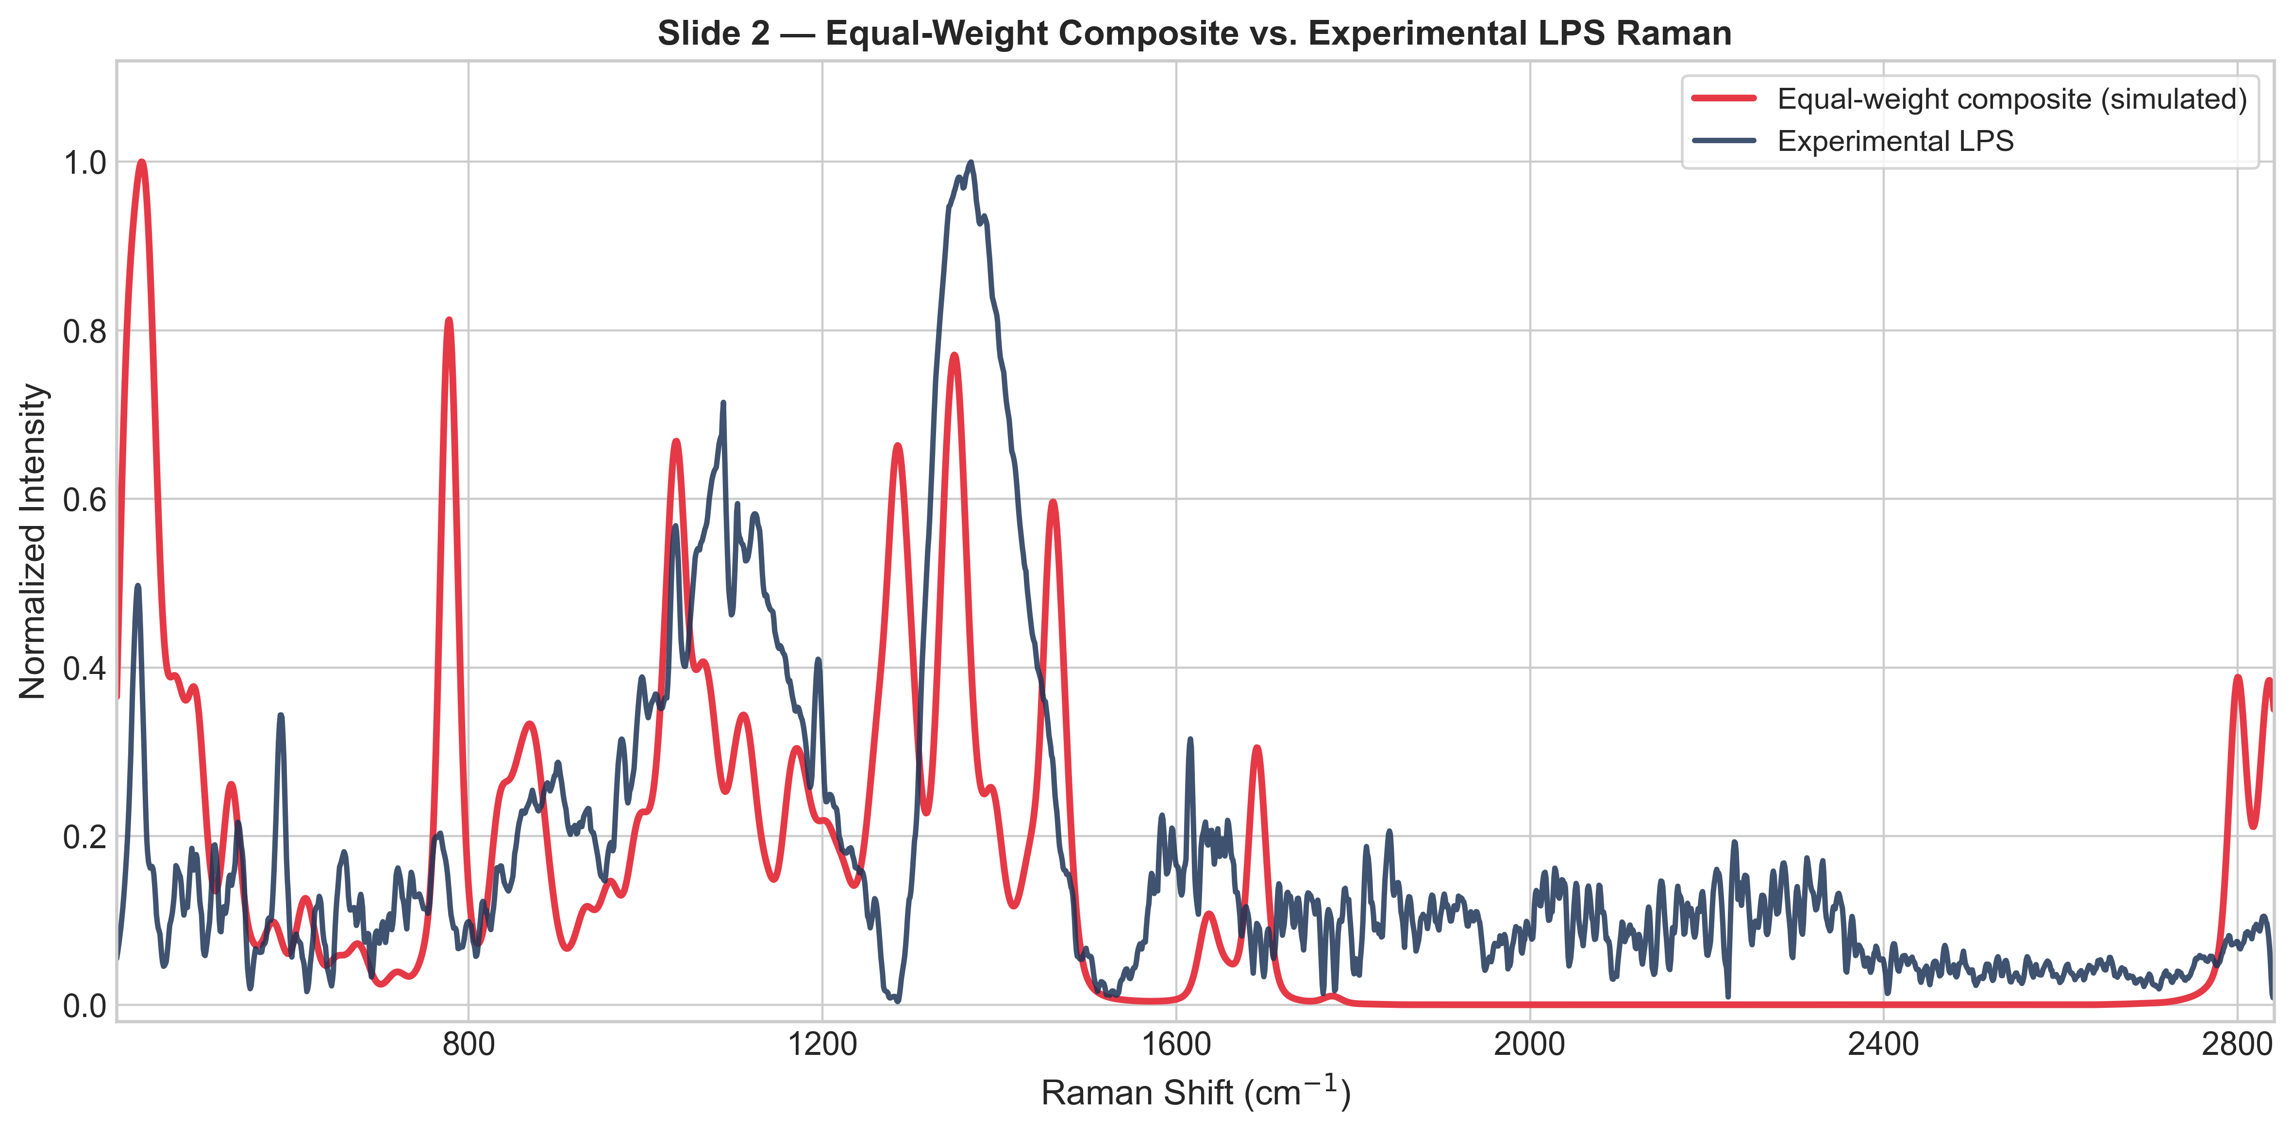

Slide 20
